Slide 1
Martha’s Vineyard Transportation Plan 2020 update
Process and outlook

Slide 2
Purpose
Long-term planning vision (covers 2020–2040)
Discussion of transportation issues, goals, and options
Recommendations based on Island needs and values
Required of all Metropolitan Planning Organizations (MPOs), including the MVC
Allows Martha’s Vineyard to access state and federal transportation funding

Slide 3
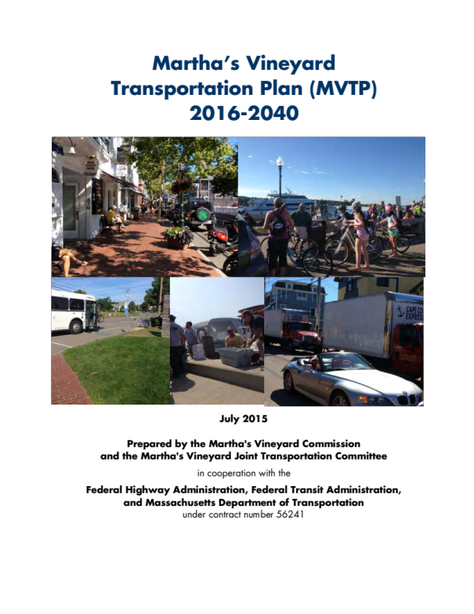
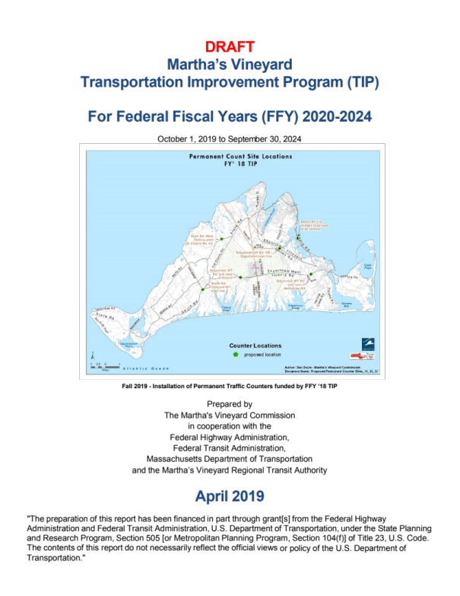
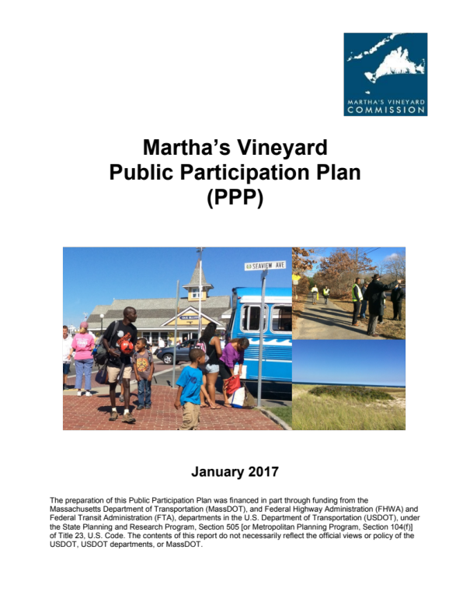
Transportation planning documents

Slide 4
Regional Transportation Plan (RTP)
Covers 25 years
Updated every four years
Identifies issues and goals
Covers all modes of transportation
Recommends projects for state and federal funding
Funded projects are later included in the Transportation Improvement Program (TIP)
Last updated in 2015

Slide 5
Transportation Improvement Program (TIP)
Covers five years (coincides with the Massachusetts five-year capital investment plan)
Updated every year
Covers all modes of transportation
Features detailed five-year budget for funded projects
Last updated in 2019

Slide 6
Public Participation Plan (PPP)
Outlines public process in regard to transportation planning
Updated every few years, or as needed
A quick-reference guide for how to get involved
Copies should be available at MVC meetings
Last updated in 2017

Slide 7
RTP participants (ideally)
Bicycle-Pedestrian Advisory Committee (BPAC)
Health Aging Martha’s Vineyard
Dukes County residents (via surveys and public meetings)
Island planning boards
The 2016 RTP update incorporated the results of an online survey, but no one provided public testimony
Efforts should be made to administer an online survey and incorporate the results in the 2020 update, and to encourage attendance at public meetings

Slide 8
2015 Transportation Survey
Shared via SurveyMonkey to 1,000 email address
Drew about 100 responses
Could be replicated with minor changes for 2019 update
1. TRANSPORTATION CONCERNS: How high a priority is it to you that each of the following be improved or protected from deterioration? (. . .)
2. TRANSPORTATION POLICIES: To what extent do you agree or disagree with the following statements? (. . .)
3. BICYCLE ACCOMMODATION: To what extent do you agree or disagree with the
following statements? (. . .)
4. CONGESTION: How much of a problem is congestion on the following roadway sections or intersections? (. . .)
5. SAFETY: What do you feel are the most dangerous intersections and stretches of roadway, for cars, bikes, and/or pedestrians? (. . .)

Slide 9
Planned improvements to 2016 update
Reorganize sections to tell a clearer story
Focus more on issues, with a clear narrative related to each transportation system
Include executive summary with graphs highlighting aspects of the plan and project recommendations
Reduce duplication throughout
Eliminate most references to data that is more than 10 years old (each of the previous two plans relied largely on the MVC’s 2009 Island Plan)
Incorporate data and trends from the 2019 Martha’s Vineyard Statistical Profile
Illustrate trends with better graphs and tables
Redesign format using InDesign

Slide 10
Time frame for update
May–June: Create and administer online survey
May–June: Finish gathering data and other materials, in cooperation with transportation system administrators, MVC staff, and Island committee members
June 15: Submit draft for MVC review and public comment
June 15–July 22: Incorporate results of survey and review
July 26: Submit final plan to MPO signatories for approval

